Slide 1
REST API

Slide 2
What is
an API?

Slide 3
What is an API?
An Application Programming Interface or API is an interface between two computer programs.
It helps developers write programs that are more maintainable and can easily communicate with other pieces of software.
Program 1
API
Program 2

Slide 4

Example of an API
An operating system exposes several API’s that applications can use to be able to access your computer’s resources.
ASM, C++
API

Slide 5

Example of an API
Chrome communicates with many of your operating system’s API’s to be able to access the internet, display stuff on the screen, get keyboard and mouse inputs, access the camera, the speakers, etc.
ASM, C++
API

Slide 6
Web API

Slide 7

What is a web API?
A Web API is the interface of a webapp with which an external program can communicate.
In short, and most commonly, it’s a server that accepts http requests and responds with json.

Slide 8
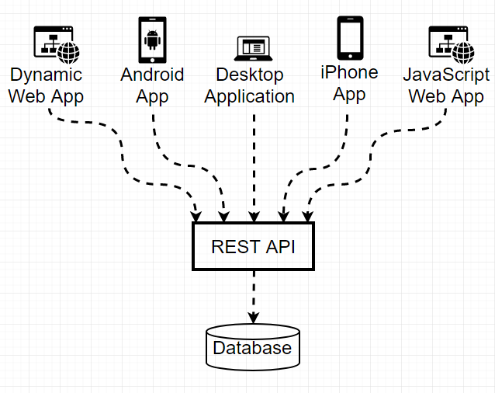
Why create an API
Why create a Web API?
An API makes our app/service available to many clients over the internet, either ours or 3rd parties’.

Slide 9
Why create an API
Why create a Web API?
It’s common to have one API but multiple clients - a react app, an android app, an iOS app, etc
In general, the API only serves data, it does not have a graphical interface.

Slide 10
REST

Slide 11
REST API
What is REST?
REST is a standard for designing web APIs - RESTful APIs.
Alternatives to REST are SOAP and GraphQL.
It is mainly a set of conventions and best practices for building web interfaces.
REST describes the following (among other things):
how to build URIs for each resource
what HTTP verbs to use for each operation
how data is received and sent in each resource
Notes:
URI: Uniform Resource Identifier (URI) is a string of characters used to identify a name or a resource on the Internet. Such identification enables interaction with representations of the resource over a network (typically the World Wide Web) using specific protocols
URL: In computing, a Uniform Resource Locator (URL) is a subset of the Uniform Resource Identifier (URI) that specifies where an identified resource is available and the mechanism for retrieving it.
Example of URI: https://i.stack.imgur.com/2iD7U.jpg
Example
To identify a specific resource and how to access it - in all completeness
URI: mysql://localhost@databasename:password
The URL shows you where you can find the database on the internet and which protocol you should use.
URL: mysql://localhost

Slide 12
REST API
How to build the URI
Right
Wrong
Get a users list:
http://mywebsite.com/users
http://mywebsite.com/user
http://mywebsite.com/getAllUsers
Get all reviews of an user:
http://mywebsite.com/users/321/reviews
http://mywebsite.com/users/reviews/321
Get user info:
http://mywebsite.com/users/56
http://mywebsite.com/users/show/56
Get a user review:
http://mywebsite.com/users/321/reviews/14
http://mywebsite.com/users/321/review/14

Slide 13
REST API
How to build the URI
Filtered and sorted list of users:
http://mywebsite.com/users?filter=client&sort=asc
http://mywebsite.com/user/filter/client/sort/asc

Slide 14
REST API
Deconstructing the URI
item #56
review #14
http://mywebsite.com/items/56/reviews/14
all items
all reviews

Slide 15
REST API
HTTP methods
The 4 most common actions we perform using a web api are create, read, update, delete - aka CRUD.
In REST the corresponding HTTP methods are the following:
POST - create
GET - read
PUT - update
DELETE - delete
These 4 methods are by far the most common and they will usually be enough to build your API

Slide 16
REST API
HTTP methods
Create a user:
POST http://mywebsite.com/users
GET http://mywebsite.com/users/create
Edit a user:
PUT http://mywebsite.com/users/14
POST http://mywebsite.com/users/14/edit
Delete a user:
DELETE http://mywebsite.com/users/14
POST http://mywebsite.com/user/14/delete

Slide 17
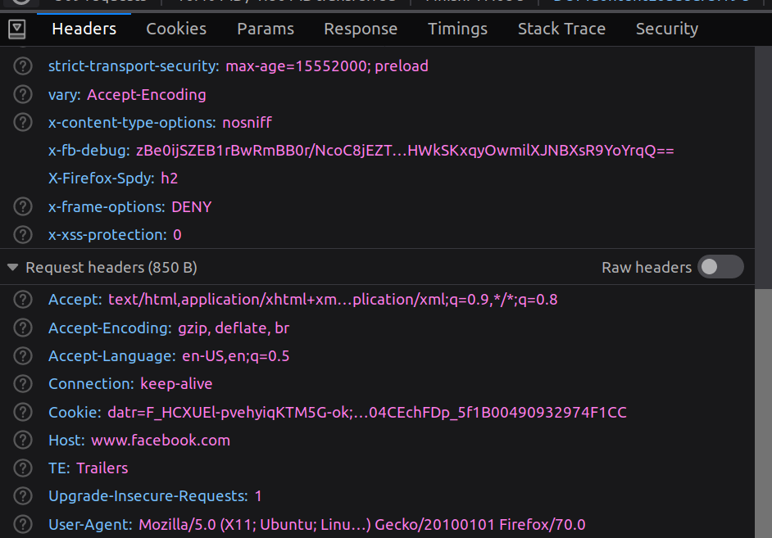
REST API
HTTP Response Formats
The response can come in many formats: HTML, XML, JSON, JSON-LD, CSV, etc.
It is up to the client to define the format it accepts via the Accept header (it can accept multiple formats)

Slide 18
REST API
HTTP Response Codes
An HTTP response always has an associated status code. It tells the client if the request was successful, if there was an error, etc.
Status codes are classified into families:
1xx - information
2xx - success (e.g.: 200 OK, 201 created)
3xx - redirect
4xx - client side error (e.g.: 400 Bad request, 401 Unauthorized)
5xx - server side error (e.g.: 500 internal server error)

Slide 19
REST API
HTTP Response Codes
When developing an API consult the list of http status codes and make sure to always send relevant status codes for each request:
https://en.wikipedia.org/wiki/List_of_HTTP_status_codes

Slide 20




REST API
Testing an API
Test all your requests using GUI programs like:
Postman - the most used
Swagger
Insomnia - postman's main competitor (lighter).
Or Text-based alternatives:
REST Client - a VSCode extension to test routes.
IntelliJ HTTP Client
They help you define the headers, body, access tokens, etc, without having to write code. You can even create documentation for your API automatically after you’ve tested the routes.

